Slide 1

Hyperglycemia and Diabetes in an ICU setting
Ian Wittler

Slide 2
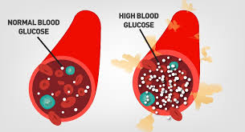
Hyperglycemia
Blood glucose levels that are very high above 200 mg/dL
Correlates highly with severe illness, yet not necessarily and predictor of outcome.

Slide 3
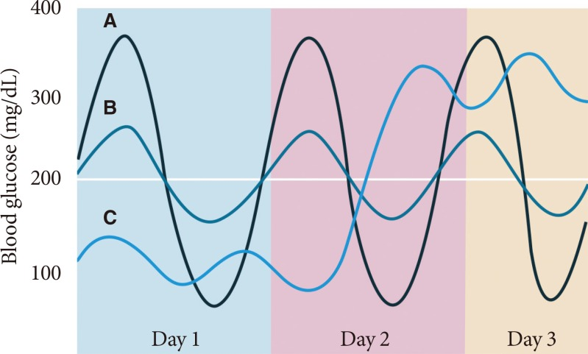
Glycemia Variability
Blood glucose levels go back and forth towards hypo and hyperglycemia
Impact of this on diabetic patients in and out of critical care is an area that could be researched further.

Slide 4
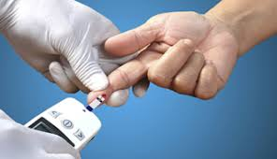
Glycemic Control
Controversial to strict(81-108 mg/dL) vs loose(<180 mg/dL) glycemic control in correlation to mortality rates.
Current research shows long term loose is beneficial and short term struct control

Slide 5
Second Paper – May 2018
Claim there are a majority of diabetic patients who have missing values? Wonder why this is.
Investigated mean glucose while I am curious about the variability in glucose levels
Looked too predict mortality with minimal values, in this case they used only 5.

Slide 6
References
https://www.ncbi.nlm.nih.gov/pmc/articles/PMC5348624/
https://www.ncbi.nlm.nih.gov/pmc/articles/PMC5961793/

